Slide 1
DoseBuddy
Madeline Rao Shishis
Melvin Mokhtari
Edward Chu
Nnamdi Nnake

Slide 2
What is the Problem?
Many older adults face challenges that result in treatment non adherence:
Forgetting
Double dosing
Key information on prescription vials difficult to read
Difficult to open (e.g., for people with arthritis)
Goal: to allow older adults to age in place, where they can take medication with the assistance of technology, but still independently

Slide 3
Why is this a Problem?
Non adherence to treatment leads to 200k deaths and cost 125bn euros yearly [1]
In 2021, 67% of Canadians reported taking or being prescribed medication in the last 12 months [2]
83% of older adults aged 60-79 take prescription medications [3]
1.3 million people in the United States are injured due to preventable medication errors each year [1]
Often documented in the inpatient and long-term care settings
Many preventable errors happen while medications are under the consumer's control

Slide 4
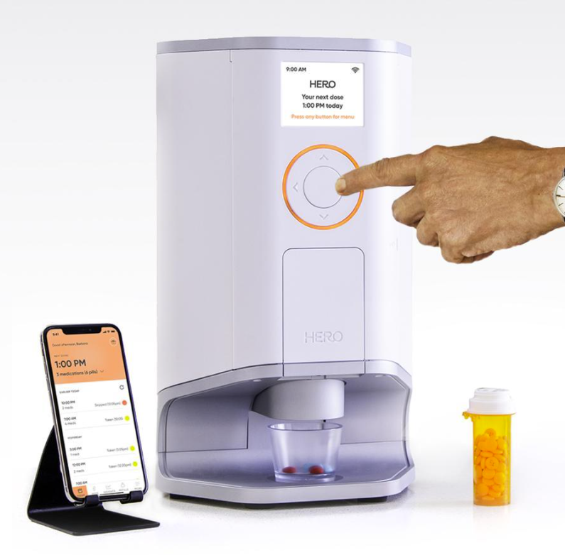
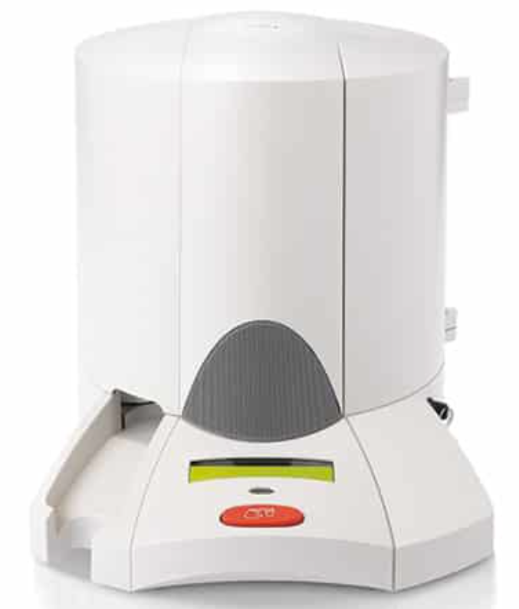
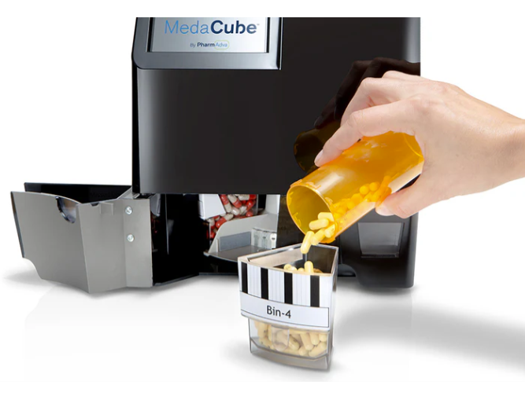
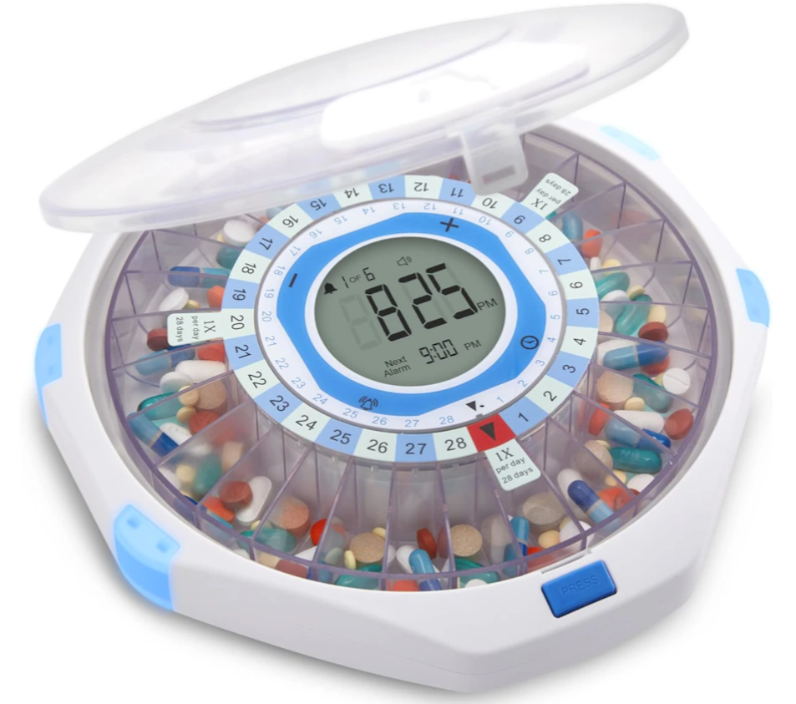
Gaps in Competing Products
HERO [4] | MedaCube [5] | LiveFine [6] | Lifeline [7]
$44 Monthly Subscription (cannot buy) Load into containers following specific instructions, automatically sorts (limit 10 medications) App connecting to healthcare professionals | >$300 Load into containers following specific instructions, automatically sorts (limit 16 medications) App that provinces reports on adherence, pill inventory, and dispensing times | $280 Must be pre-loaded by hand App that connects family members to monitor dosages | $90 + App Subscription Prefilled dosing cups placed in order they need to be taken (up to 60 cups) App that connects family members and battery (monthly subscription)

Slide 5
How will we Solve this Problem?
Features:
Spiral Compartment Design: 28 compartments for a week’s supply (4 doses per day).
Motorized Rotation: Smooth, automated movement to the next dose.
App Integration: Tracks compartments, ensures timely refills, and monitors usage.
Caregiver-Friendly: Pharmacist or caregiver refills once a week for convenience.
How It Works:
Step 1: Refill compartments weekly.
Step 2: Device rotates automatically at scheduled times.
Step 3: Pills are dispensed, and the next compartment aligns.

Slide 6
Why We Stand Out?
More Compartments, Fewer Refills
Preloaded by Professionals, Controlled by App
Target Price: <$90 (Beats Competitors)
First App-Connected Spiral Dispenser
Familiar Design, Smarter Tech
Suitability and Feasibility

Slide 7
Major Milestones
Milestone | Deliverable | Timeline | Key Tasks
Proposal Report | 1-page report (Feasibility, Milestones) | Jan 28th | Outline app/3D model approach, justify feasibility, team roles.
3D Model Design | Virtual spiral mechanism (Blender/Fusion) | Feb 11th | Design 3D model with compartment logic; simulate rotation.
App Prototype | Wireframes + Basic Notification System | Feb 25th | Develop app UI/UX and time-based alerts.
User Feedback & Refinement | Test report + Iterated design | Mar 25th | Simulate user workflows; adjust app/3D model.
Final Report & Presentation | Full documentation + Demo | Apr 7th | Compile results, finalize app, and present.

Slide 8
Team Contributions
Member | Expertise | Responsibilities | Deliverables
Madeline | Mechanical Engineering, CAD Design | - Design the 3D digital prototype (spiral compartment mechanism). - Simulate rotation logic for 28 compartments. | CAD model (digital prototype)
Melvin | Computer Science/Engineering | - Develop the app (scheduling, notifications). - Implement core features (time-based alerts, refill reminders). | Working app prototype
Nnamdi | Research, Writing | - Lead written reports (survey, final). - Research user needs/competitors. | Polished reports
Edward | Biomedical Eng, Health Sci | - Define user requirements (compliance, accessibility). - Assist in development of app/CAD usability. | Testing protocols, user feedback summary.

Slide 9
References
Paolo Marmaglio, Davide Consolati, R. Formicola, R. Rodella, R. Faglia, and M. Tiboni, “Home Pill Dispenser Operating Technologies: Automation Mechanisms Comparison,” Mechanisms and machine science, pp. 529–537, Jan. 2024, doi: https://doi.org/10.1007/978-3-031-64569-3_60.
S. C. Government of Canada, “Pharmaceutical access and use during the pandemic,” www150.statcan.gc.ca, Nov. 02, 2022. https://www150.statcan.gc.ca/n1/pub/75-006-x/2022001/article/00011-eng.htm
“Products - Data Briefs - Number 347 - August 2019,” 2019. https://www.cdc.gov/nchs/products/databriefs/db347.htm
“Hero - A dose of calm for the whole family,” Hero, 2024. https://herohealth.com/manage-my-meds-4/?correlationId=30e64bf8-b872-4710-b258-affff3043daf
“Usage,” MedaCube. https://www.medacube.com/pages/usage
“LiveFine WiFi Automatic Pill Dispenser & 28-Day Remote Medication System W/Lock & Key - Frosted Lid - TSC.ca - Online Shopping for Canadians,” Www.tsc.ca, 2020. https://www.tsc.ca/LiveFine-WiFi-Automatic-Pill-Dispenser-28Day-Remote-Medication-System-WLock-Key-Frosted-Lid/pages/productdetails?nav=R:891102
“Medication Dispenser Support,” Lifeline. https://www.lifeline.com/support/dispenser/

Slide 10
THANK YOU FOR LISTENING!

